Slide 1
Student Name : J. Janani Register No : 36324U18018 NM ID : astvu36336324u18018 Department : BSc(Computer Science ) College Name : Sree Abiraami Arts & Science College for Women University : Thiruvalluvar University Date of Birth : 08/04/2007 Gender : Female Current sem : 3
DIGITAL PORTFOLIO

Slide 2
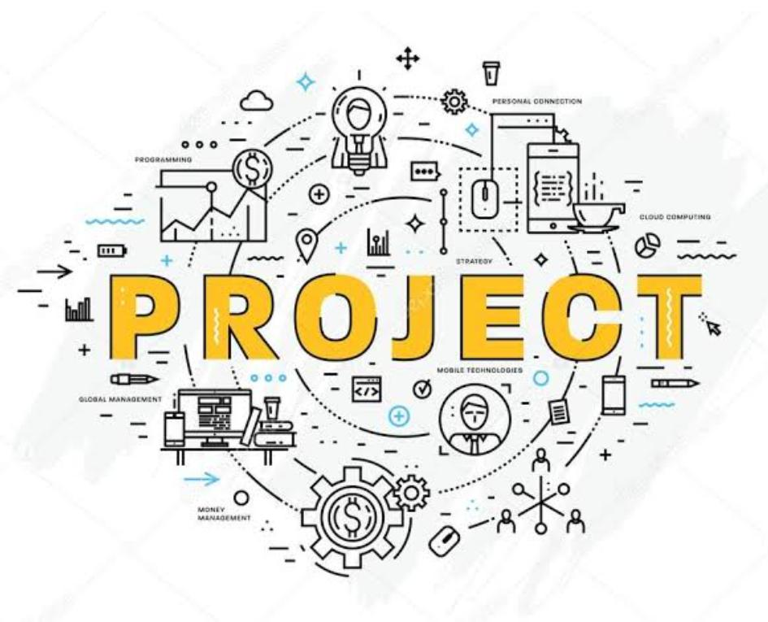
📌 PROJECT TITLE :
1.My digital portfolio: A front-end development project
2. Student digital portfolio using HTML, CSS & JavaScript
3. Personal portfolio website – A front-end project
4. Janani’s digital portfolio: A modern web design approach

Slide 3

💡AGENDA
1.Problem Statement 2.Project Overview 3.End Users 4.Tools and Technologies 5.Portfolio design and layout 6.Features and Functionality 7.Result and Screenshot 8.Conclusion
9.GitHub link

Slide 4

Problem Statement
In today’s competitive world, resumes alone cannot fully represent a student’s skills, creativity, and achievements. A responsive portfolio website solves this problem by providing an interactive space to highlight projects, skills, and accomplishments effectively.

Slide 5
Project overview
➪ Project overview: personal portfolio website.
➪ Core features:
☞ About
☞ Certificate
☞ Contact
☞ Skills
☞ Project
➪ Main idea:
☞ Create a personal portfolio website to showcase about , certificate & achievements, skills, projects & contact.

Slide 6

Who Are the end users?
➪ The student digital portfolio can be beneficial for a wide range of users:
* Student – to showcase their academic progress, skills, projects, and certifications in a structured digital format.
* Job seekers – to present their resume and achievements interactively, helping them stand out in recruitment processes.
* Freelancers – to display their work, technical expertise, and client projects to attract potential opportunities.
* Professionals – to maintain an online profile that highlights their experience, achievements, and career growth.

Slide 7
Tools And Techniques
☞To develop the student digital portfolio, the following tools and techniques are used:
* Html (hypertext markup language):
The content of the portfolio, including sections like about, education, skills, projects, certificate and contact.
* CSS (cascading style sheets): for designing and styling the web pages
* JavaScript (JS): for adding interactivity and dynamic features such as navigation menus, form validation, and smooth transitions.
* Code editor – visual studio code (VS code)
* Web browser -(google chrome/edge)

Slide 8

Portfolio design layout
1. About me
🔸 A brief introduction of Janani. J
🔸 Educational background (B.Sc. Computer science
2. Projects
🔸Showcasing academic and personal project
🔸 Each project with a title, description, tools used, and GitHub/demo link (if available)
3. Skills
🔸 List of technical skills (HTML, CSS, JavaScript, C, python, etc.)
🔸Soft skills (teamwork, communication, problem- solving)
🔸Visual representation (skill bars or icons)
4. Contact
🔸Contact form (name, email, message)
🔸Direct contact details (email ID, LinkedIn, GitHub link)

Slide 9
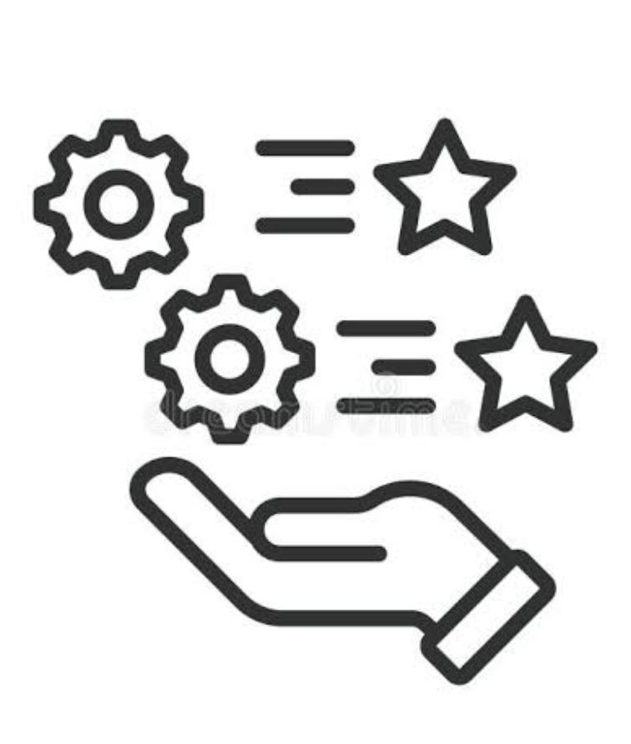
🎗️Features and functionality
1.Navigation Bar (menu / header).
✯ Smooth scrolling to different sections.
✯ Highlight active section when scrolling.
2. Project section grid layout to showcase projects (with image + title).
✯On hover → show description used
(HTML, CSS, JS, python, etc.).
✯ Link to GitHub repository or live demo.
3. Contact section simple form: name, email, message.
✯ Email integration
✯ Social media icons (LinkedIn, GitHub, etc)
4. Responsive design mobile + tablet + desktop compatible.
✯ Flexible grid layout for projects and skills.
✯ Navigation menu to hamburger in small screens.

Slide 10
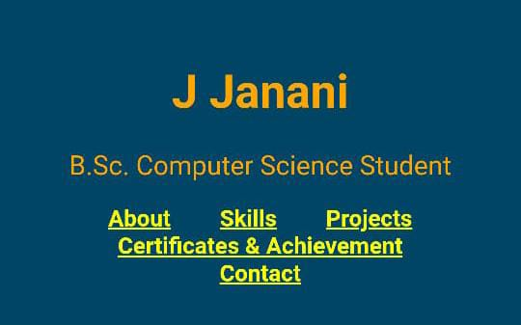
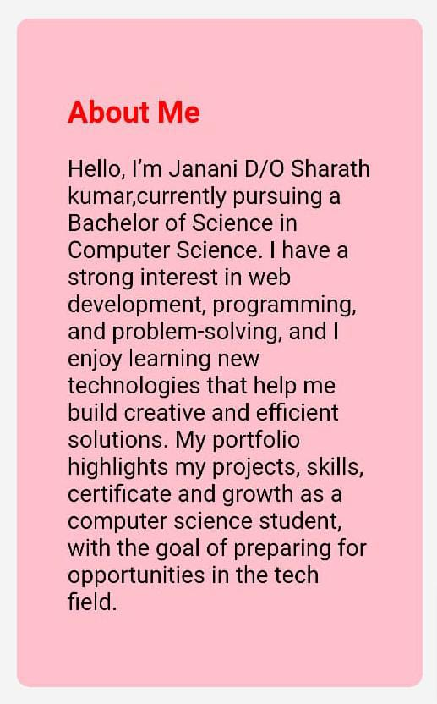
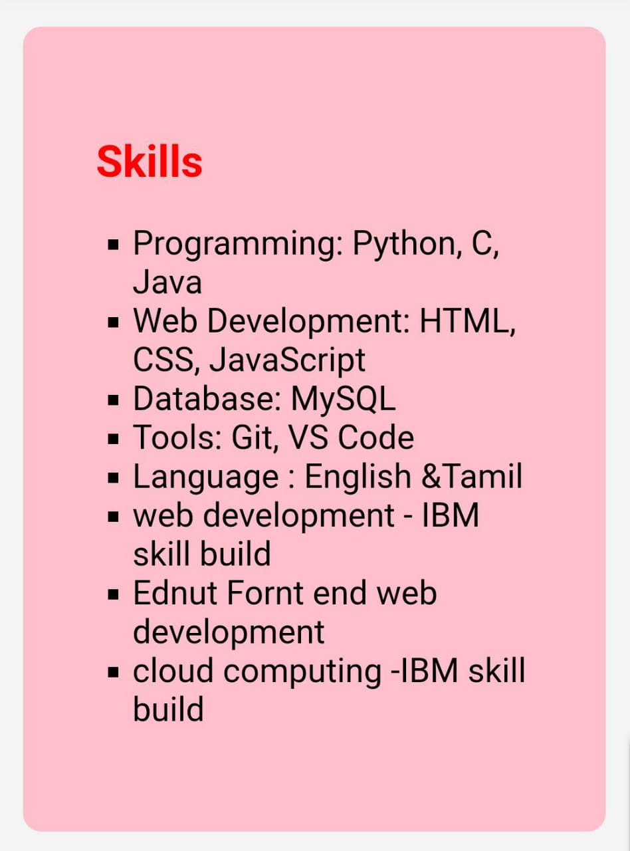

RESULT AND SCREENSHOT

Slide 11
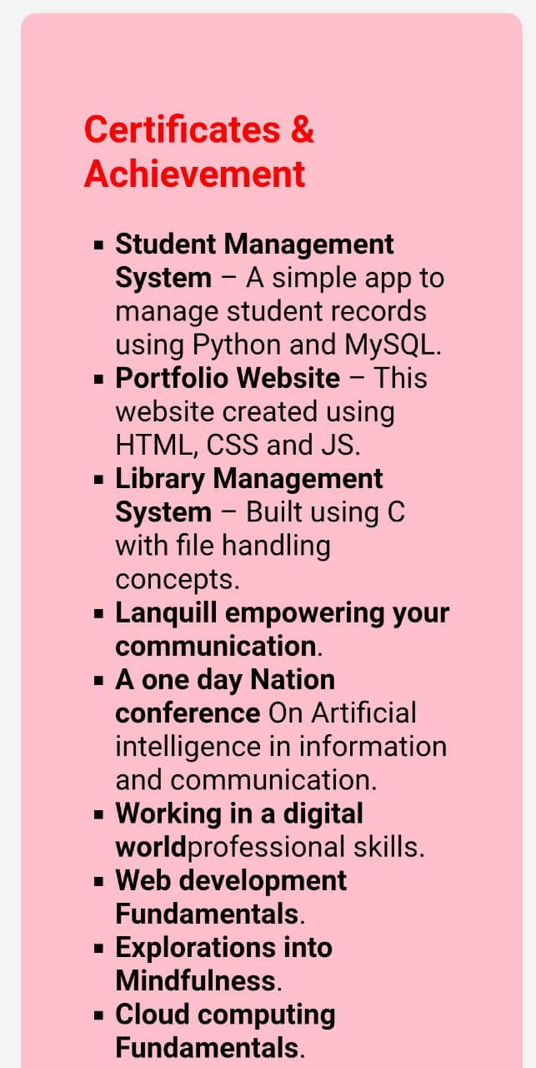
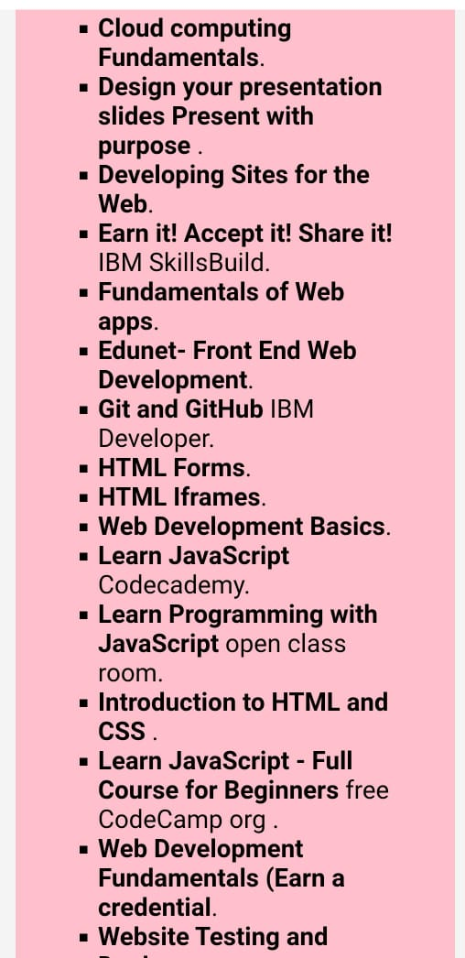

Slide 12
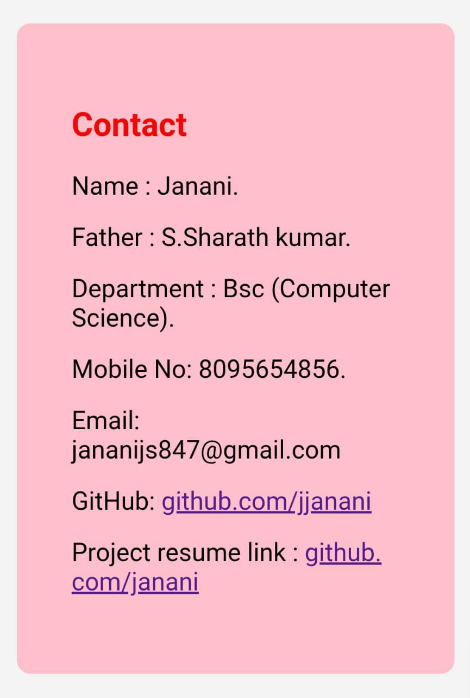
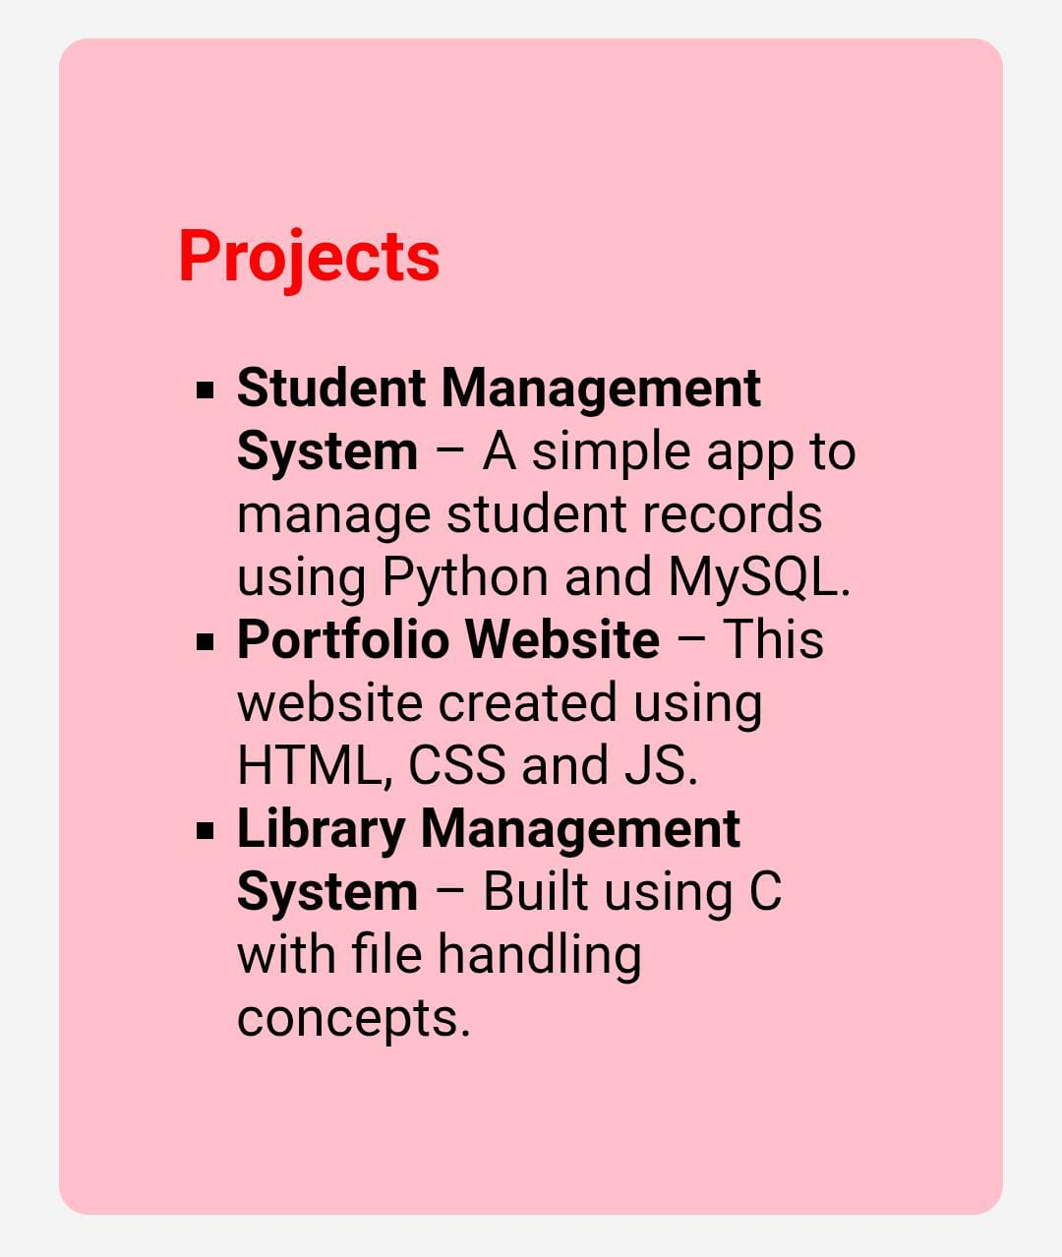
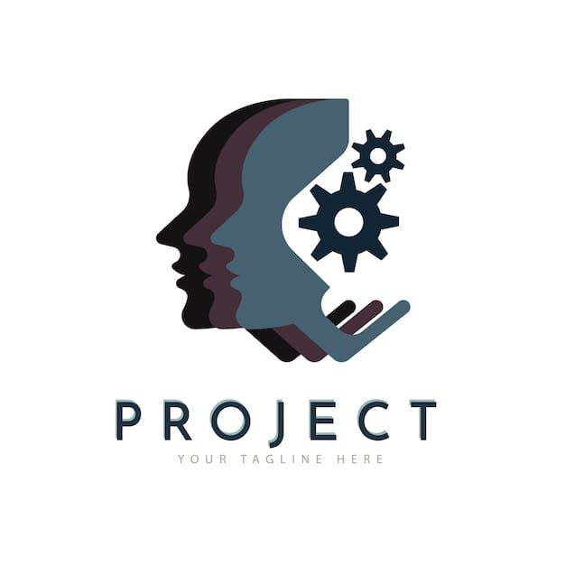

Slide 13


CONCLUSION
HIGHLIGHTS OF OUR PROJECT
☞︎ My project highlights responsive design, interactive features, easy navigation, showcasing skills and projects effectively for students and professionals.
FINAL SUMMARY
☞︎ This portfolio project showcases my skills, projects, and achievements with a clean, responsive design. It serves as a professional platform for future opportunities.
BENEFITS OF SOCIETY
☞︎ A portfolio project benefits society by showcasing skills that inspire learning and innovation. It helps students and professionals present their talents for better opportunities.

Slide 14
GITHUB LINK
This is my GitHub URL :jananijs0819/portfolio
My Project and My Digital portfolio link : https://jananijs0819.github.io/portfolio/

Slide 15
Thank you:
Presented by :
Name : J. Janani
Year : Second year
Department : BSc (Computer Science)
College name : Sree Abiraami Arts and Science college for womem
Place : Keelalathur

